Slide 1
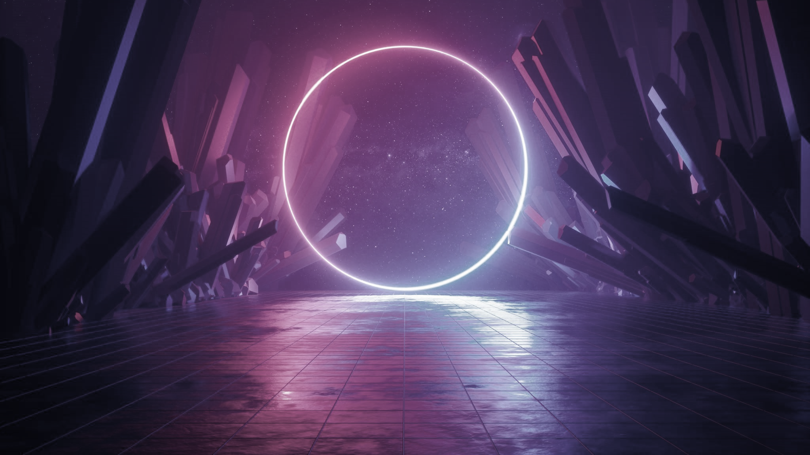
Translokation in Virtual Reality

Slide 2
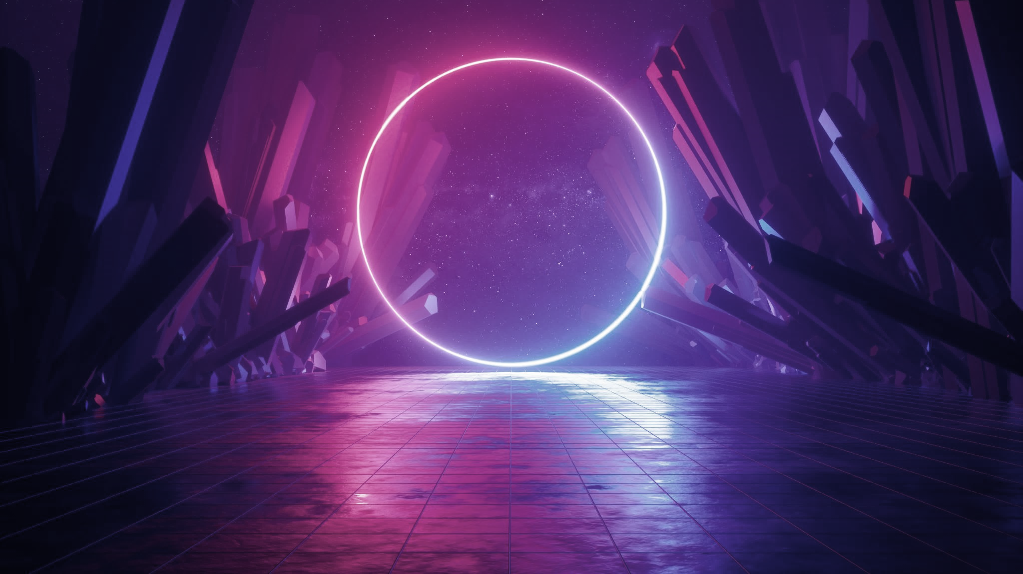
Wo kommt Translokation in anderen Medien vor?
Bücher
Filme
Videospiele

Slide 3
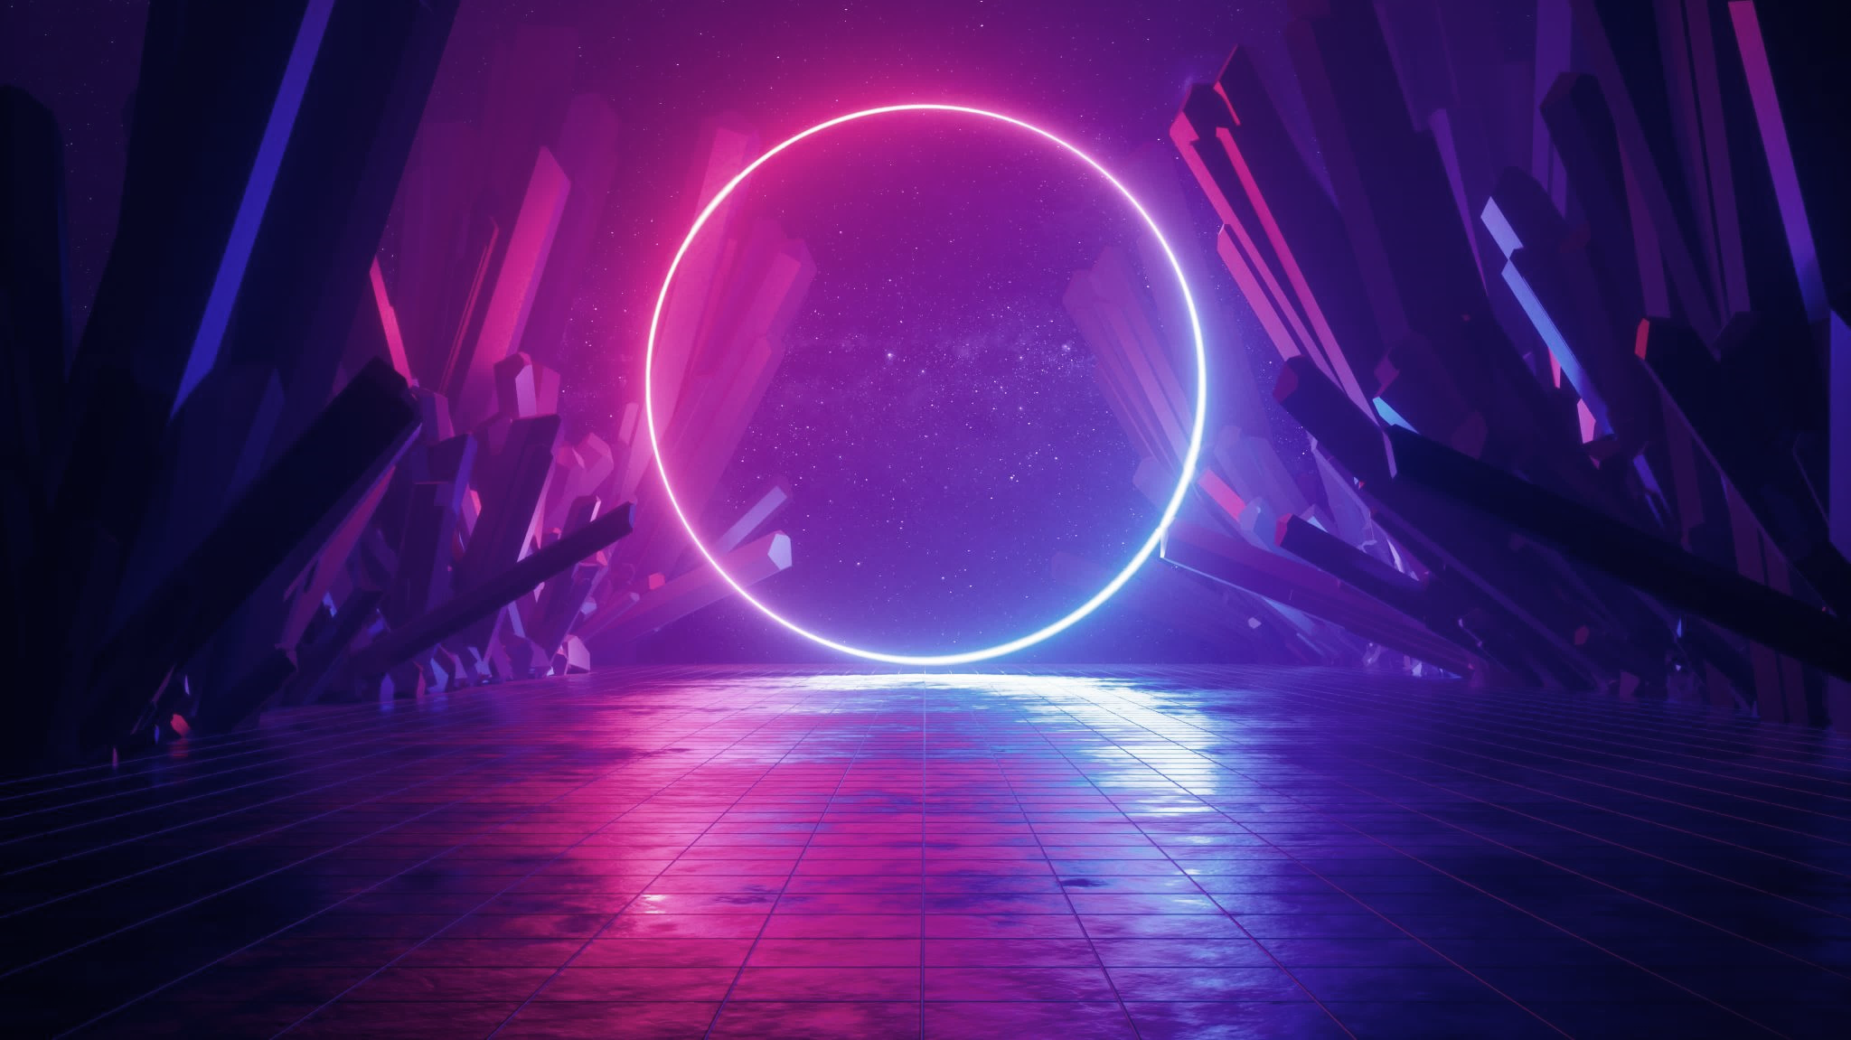

Translokation am Beispiel des Filmschnitts

Slide 4
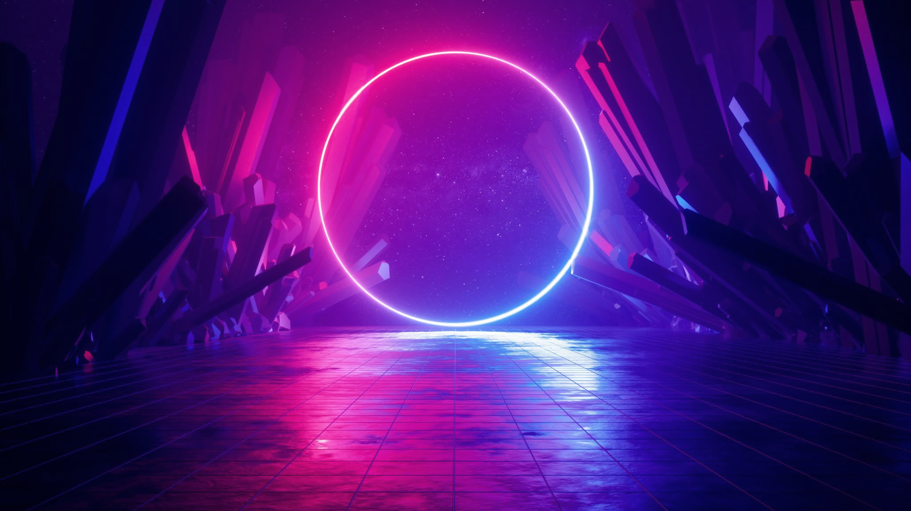
Warum ist Translokation wichtig?
Überbrückung von zeitlichen und räumlichen Sprüngen [1]
Stärkung der Immersion und körperlichen Präsenz [2]
Reduktion von Cybersickness [1, 3]

Slide 5
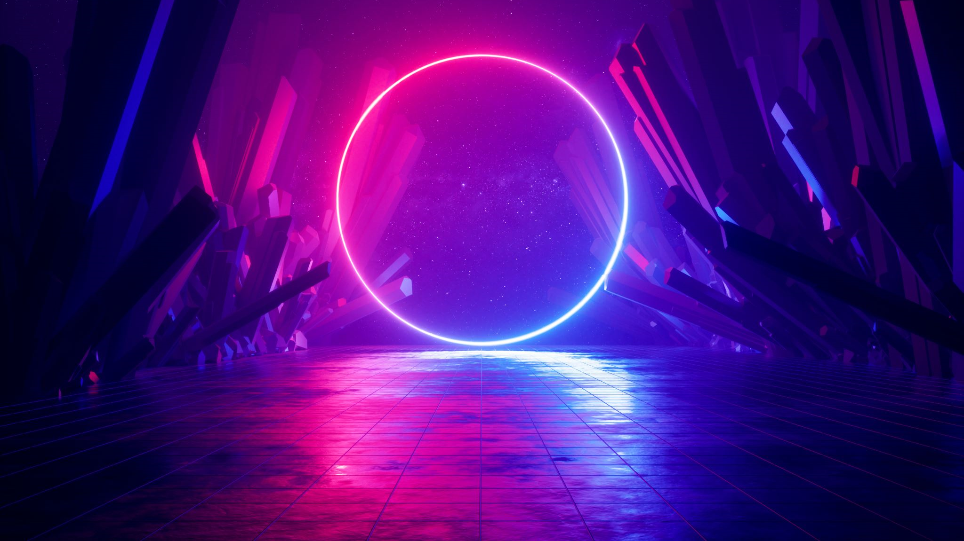
Eure Ideen

Slide 6
Quellen
L. Men, N. Bryan-Kinns, A. S. Hassard and Z. Ma, "The impact of transitions on user experience in virtual reality," 2017 IEEE Virtual Reality (VR), Los Angeles, CA, USA, 2017, pp. 285-286, doi: 10.1109/VR.2017.7892288
[1] K. Rahimi, C. Banigan and E. D. Ragan, "Scene Transitions and Teleportation in Virtual Reality and the Implications for Spatial Awareness and Sickness," in IEEE Transactions on Visualization and Computer Graphics, vol. 26, no. 6, pp. 2273-2287, 1 June 2020, doi: 10.1109/TVCG.2018.2884468
[2] F. Steinicke, G. Bruder, K. Hinrichs, A. Steed and A. L. Gerlach, "Does a Gradual Transition to the Virtual World increase Presence?," 2009 IEEE Virtual Reality Conference, Lafayette, LA, USA, 2009, pp. 203-210, doi: 10.1109/VR.2009.4811024
[3] L. Men, N. Bryan-Kinns, A. S. Hassard and Z. Ma, "The impact of transitions on user experience in virtual reality," 2017 IEEE Virtual Reality (VR), Los Angeles, CA, USA, 2017, pp. 285-286, doi: 10.1109/VR.2017.7892288

